Slide 1
A CD of this message will be available (free of charge) immediately following today's message
This message will be available via podcast later this week at calvaryokc.com
15-16

Slide 2
15-16
Deut. 25:17-19 ~ ¹⁷ Remember what Amalek did to you on the way as you were coming out of Egypt, ¹⁸ how he met you on the way and attacked your rear ranks, all the stragglers at your rear, when you were tired and weary; and he did not fear God. ¹⁹ Therefore it shall be, when the LORD your God has given you rest from your enemies all around, in the land which the LORD your God is giving you to possess as an inheritance, that you will blot out the remembrance of Amalek from under heaven. You shall not forget.

Slide 3
15-16

Slide 4
15-16
John Trapp ~ "If Saul spare Agag, the people will take liberty to spare the best of the spoil . . . the sins of the great command imitation."
Alexander Maclaren ~ "Partial obedience is complete disobedience. Saul and his men obeyed as far as suited them; that is to say, they did not obey God at all ..."

Slide 5
15-16

Slide 6
15-16
Regret ~ KJV, repenteth
NIV, I am grieved that I have made Saul king

Slide 7
15-16

Slide 8
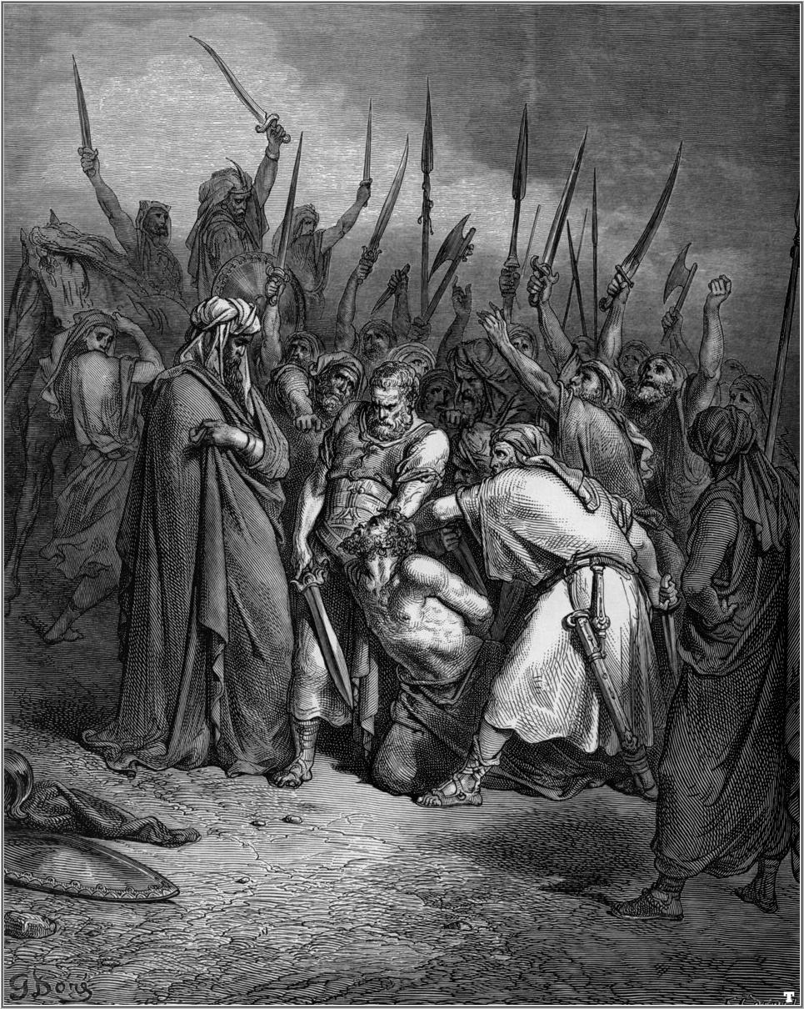
15-16
Cautiously ~ KJV, delicately

Slide 9
15-16

Slide 10
15-16
Literally: Man sees the eyes, but God sees the heart

Slide 11
15-16

Slide 12
15-16
Alan Redpath ~ "You may not be intellectual or well thought of in your family circle; you may be despised by others for your faith in Christ. Perhaps you had only a little share in the love of your parents, as David did. But remember that those who are rejected of men often become beloved of the Lord."

Slide 13
15-16

Slide 14
15-16
Adam Clarke ~ “God seems to have taken what gifts he had, and given them to David; and then the evil spirit came upon Saul; for what God fills not, the devil will.”

Slide 15
15-16

